Slide 1
The Agile Inception Deck
Template

Slide 2
Happy Valley Kennels
Jim and Sally Reed
Notes:
Project name – pick a cool sounding name for your project
Sponsors – list your project sponsors here (the people with the money)
Putting your sponsors name boldly out there for all to see is a great way to get their engagement and attention (necessary for any successful project).

Slide 3

Why are we here?
Improve the current manual system
Give HVK an online presence
Making reservations easy
Establish an online presence to retain customers
Notes:
Write down all the reasons why your company would want to spend money on this project in the first place.
Then pick and highlight the most important one.

Slide 4
The elevator pitch
For Jim and Sally Reed
who need an online system
the HVK registration system
is a web application
that allows customers to book online
Unlike the current paper and phone system
our project is online and easy

Slide 5
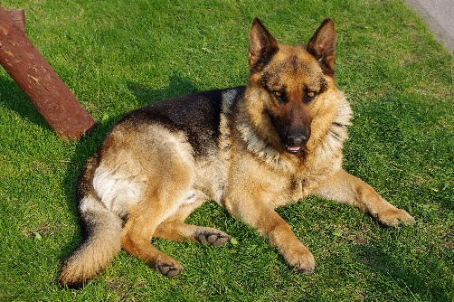
Product box
HVK reservation system
Giving your pets a home away from home
Online presence
Ease of use
Replace paper system
Notes:
If you could walk into a store, and buy the shrink wrapped version of your software, what the design of the box look like and what would it say?
Point here is to get your team looking at your project through the eyes of your end customer.

Slide 6
The NOT list
IN | OUT
Customers book reservations | Live stream pets to customers
Customers have dogs | Birds
Dogs have vaccinations | Profile picture
Dogs have vets | Pet picture
User input is validated
Input is stored in database
UNRESOLVED
Owners don’t decide food
Owners can’t input medication
Owners can’t book for cats
Notes:
List all the big ticket items you are (and are NOT) going to deliver within the scope of this project.
Before starting your project move all the UNRESOLVED ones to either IN or OUT.

Slide 7



Your project community
Database guy
Your core team
Back end developer
Front end developer
Jim and Sally
... is always bigger than you think!
Notes:
List everyone you are going to have to interact with at some point during the course of your project.
Goal is to start building relationships with these people and let them know we are coming down the tracks (before we actually get there).

Slide 8



Technical solution
SQL Server
ASP.NET
HTTP
Technologies:
C#, SQL
SQL Server, ASP.NET
Visual Studio, SQL Server
ASP.NET
Danger!
Out of scope
Notes:
This is about letting people know how we plan on building this thing.
If there are any tools or libraries assumptions you are making list them here.
Also if there are areas of the application architecture that are risky highlight those too.

Slide 9

What keeps us up at night
Pets dying in our care
Doing everything on paper
Our database failing
Notes:
This is your chance to call out any craziness you’ve heard while building the deck, and having a frank conversation with your sponsors and your team about how you are going to handle it.
This is perhaps on of the most powerful slides in the deck – it’s your chance to ask for whatever you need to be successful and the consequences if you don’t get it.
Use it!

Slide 10

How big is this thing?
Ship it!
Construction
UAT
Training
~7 months
1 wk
1 wk
This is a guess. Not a commitment.
Notes:
Give your sponsors some idea of how big this thing is (1, 3, or 6 monther).
Before you can complete this slide you and the team should create and estimate a high-level story list for the project.
This isn’t a commitment (too many unknowns). It’s just a really rough guess. Don’t treat it as anything else.

Slide 11
Trade-off sliders
 | The classic four
 | Feature completeness (scope)
 | Stay within budget (budget)
 | Deliver project on time (time)
 | High quality, low defects (quality)
OFF
ON
OFF
ON
OFF
ON
OFF
ON
 | Other important things
 | Ease of use
 | Don’t make me think!
 | Detailed audits (log everything)
OFF
ON
OFF
ON
OFF
ON
Notes:
When push comes to shove, something has to give. Here we want to be clear on what that is.
On agile projects we flex on scope. But there could be others factors at play here so get ready to listen as you customer tells you which forces can bend (scope) and which are written in stone (usually budget).
Slider rules:
1. No two sliders can occupy the same level.
2. List other important project factors down below.

Slide 12

The first release
Ship it!
Construction
UAT
Training
~7months
1 wk
1 wk
4 people, 7 months, $0
Notes:
Stakeholders are usually interested in two things:
How much is this going to cost.
When is it going to be done.
Here we do our best to answer those two questions so they can decide if the project is still worth doing by showing them what it’s going to take.

Slide 13
